Slide 1


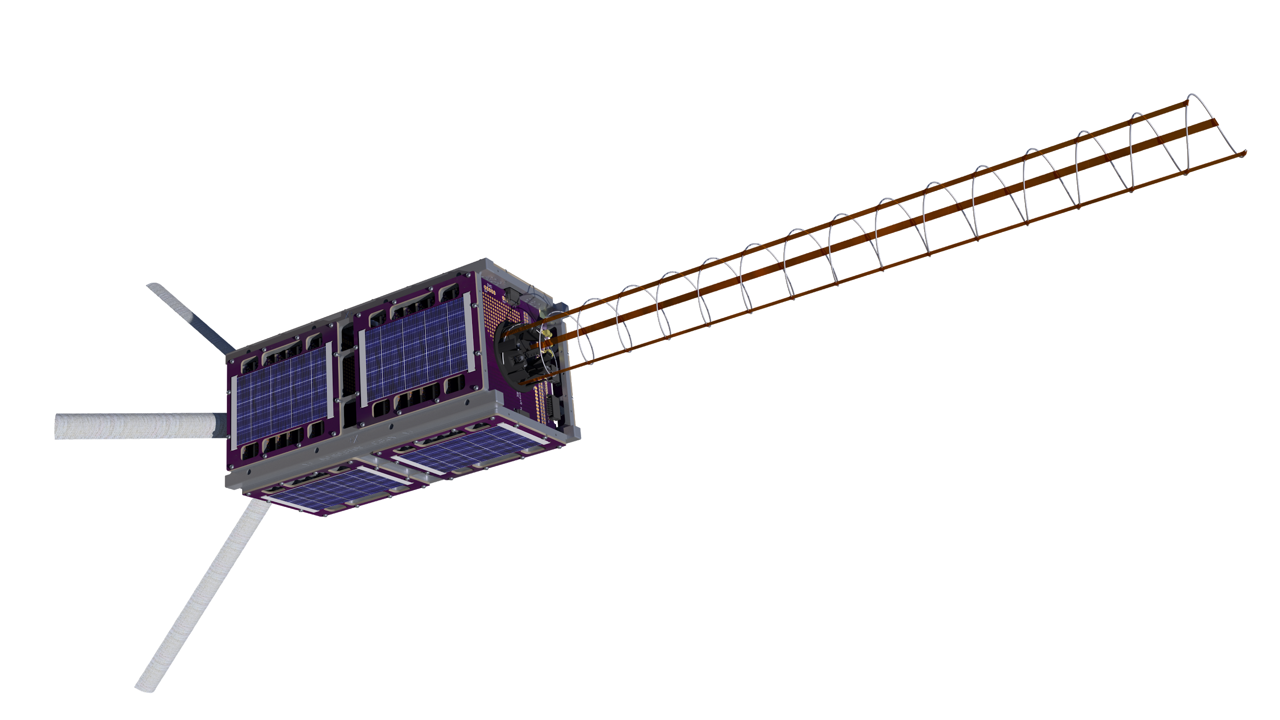
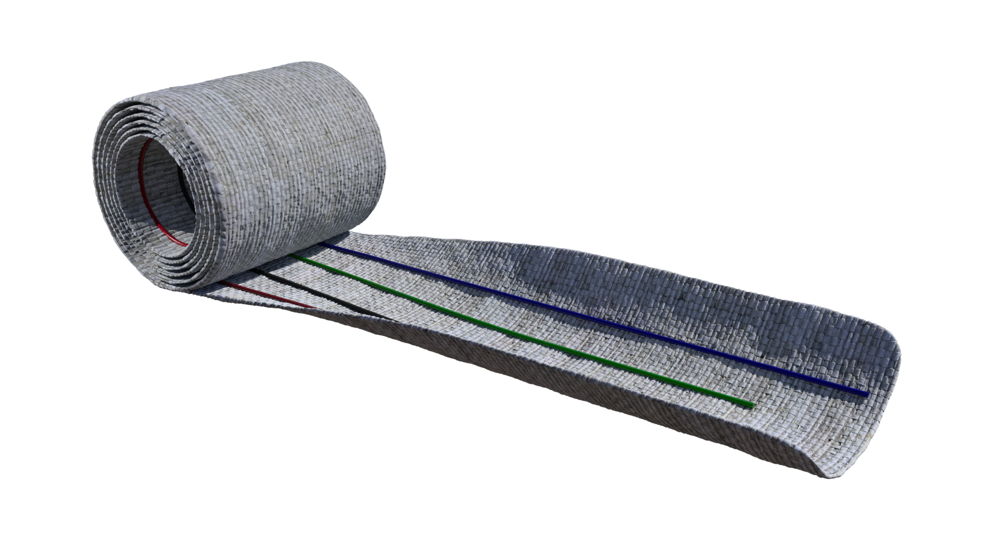
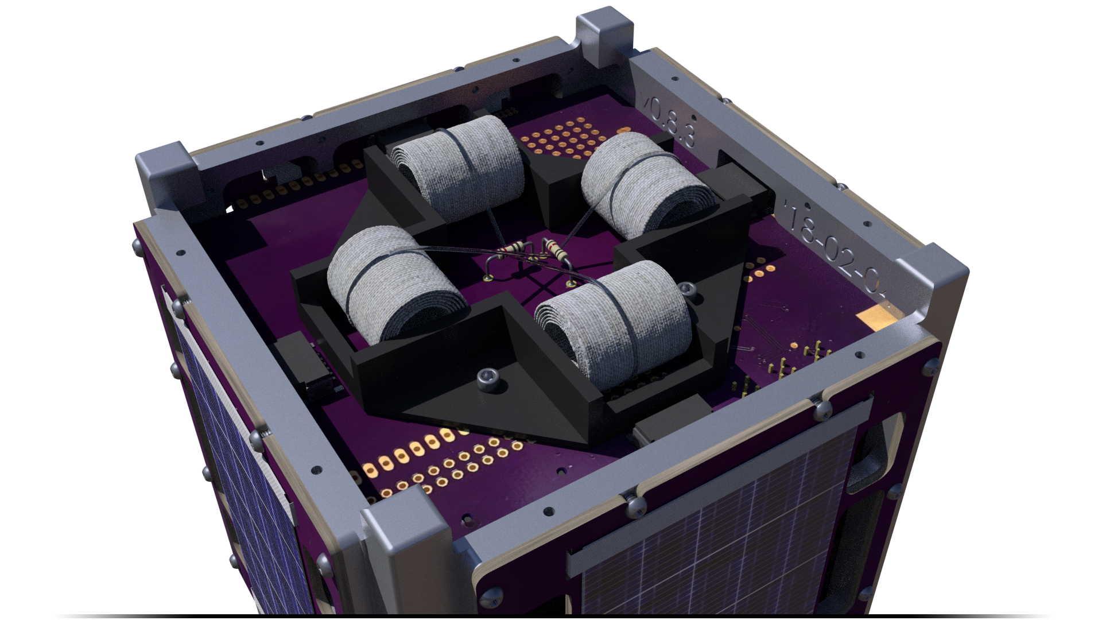
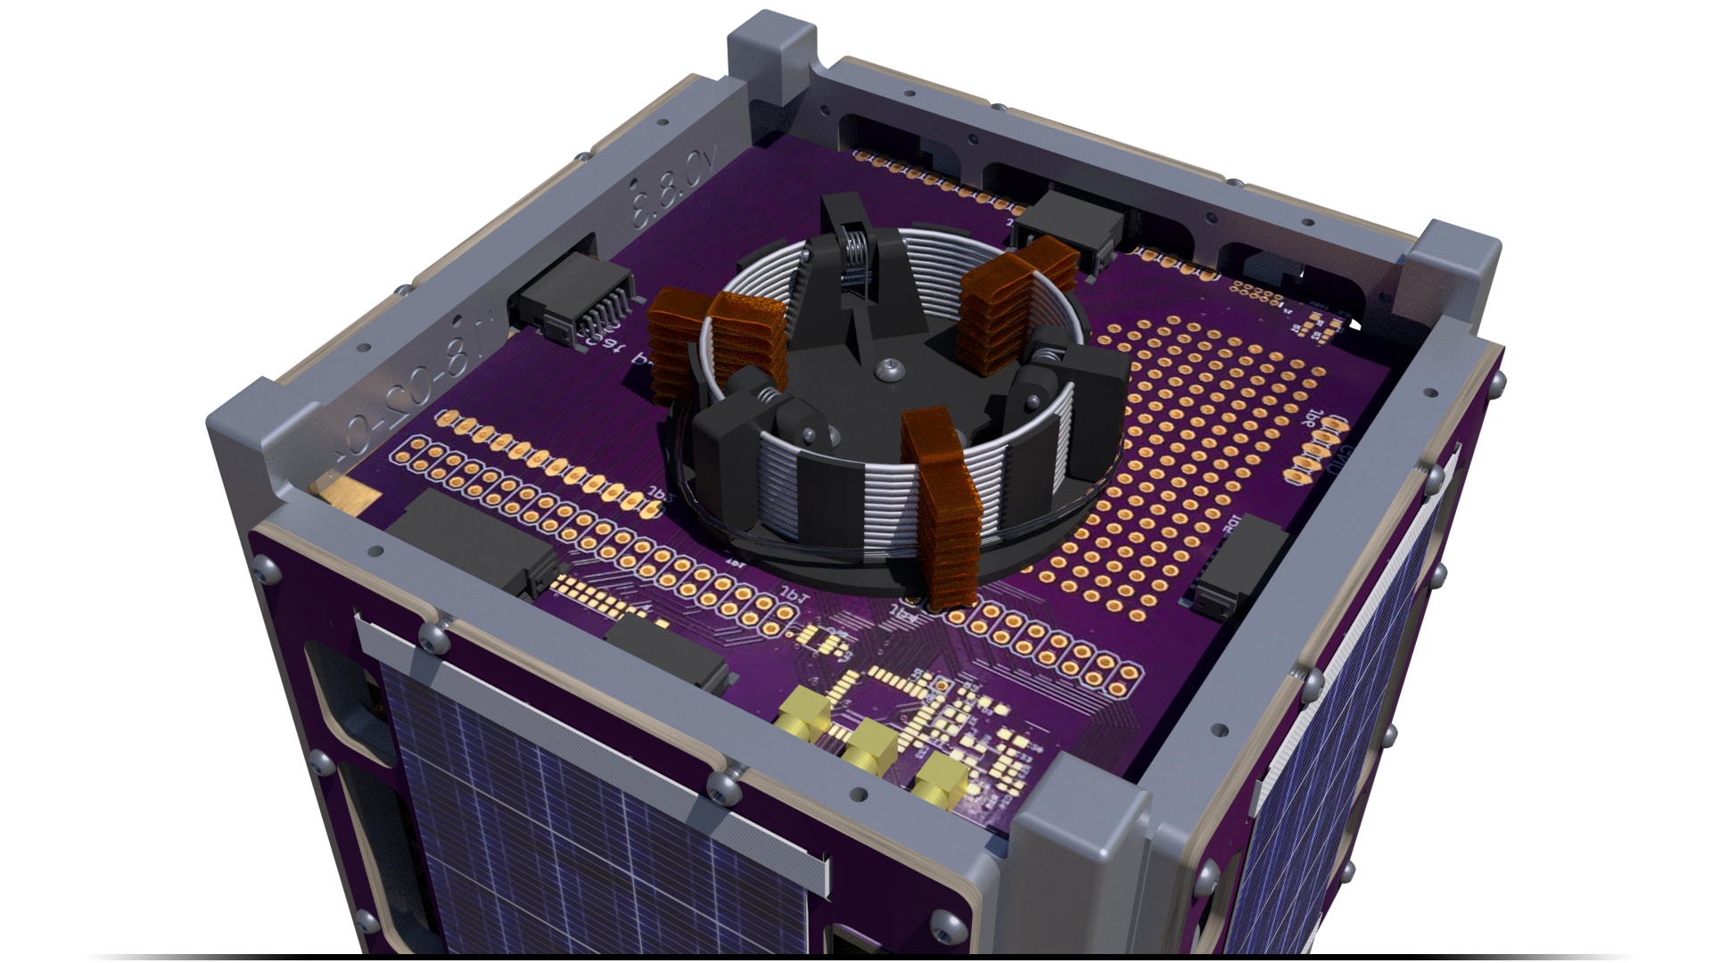


OreSat Deployable Antennas
John George ∘ Paijanne Jones ∘ Calvin Young ∘ Justin Burris ∘ Shivani Nadarajah
2018
Canted Turnstile Array
S Band Helical Antenna
Mission
deployment is mission critical
enables OreSat’s primary objective to establish baseline communication with groundstation-- necessary for bringing control systems online
consists of four poles-- each with four embedded antennas-- fixed at 90 degree intervals
each pole canted to 35 degrees
emits an omni-directional, 436.5 MHz low gain radio signal
enables OreSat’s secondary mission of space-based STEM outreach
highly directional, relies on attitude control system to point at Oregon as it flies overhead
transmits a high definition video signal to handheld receivers built by high school students
high gain WiFi-based (802.11b) 2.4 GHz signal
Design and manufacture two separate antenna deployment systems for Oregon’s first satellite
OreSat is ramping up to be Oregon’s first educational nanosatellite! It’s a CubeSat-- a standard form factor for nanosatellites consisting of a 10 cm cube per unit. Thanks to NASA’s CubeSat Launch Initiative, we will be sending our satellite to the International Space Station where it will be released into low Earth orbit.
For more information, visit oresat.org
stowed, flat cylinder: stable configuration 1
deployed tape with radius: stable configuration 2
transition zone
bistable, fiberglass tape spring
with four embedded antenna wires
Mechanical Design
Structural Elements
must be compressed to 15 mm when stowed and released to 460 mm during operation
competing commercial designs are costly, relatively complex, and too bulky
bonded polyamide tethers keep the antenna partially compressed, accurately defining the deployed length and providing structural rigidity
three spring-loaded hinges constrain the spring during the intense launch vibrations
must withstand the extreme temperatures and vacuum of space
four non-conductive, bistable, fiberglass tape springs
bistability of the springs allow each pole to be rolled into a flat cylinder held for stowage using a monofilament line known as a burn wire
burn wires are held in tension with resistors
deployment is triggered when the burn wires are caused to fail by overloading the resistors
turnstile antenna
stowed configuration
Special Thanks
helical antenna
stowed configuration
Andrew Greenberg and Glenn LeBrasseur
for sponsoring the project and herding all of the electrons
Gerald Recktenwald
for providing fantastic guidance as our faculty advisor
Dependable Springs
for the precise manufacturing of our helical antennas
HP Dynamics Lab
for their generous assistance with all things vibration
HP Model Shop
for supplying high-quality 3D prints of our design prototypes
Oregon Small Satellite Project

